Slide 1
Signal Synchronization
The problem:
Signal latency causes incorrect data capture
We can expect latency between the Kinect and Wearable sensors.
The solution:
Calibration exercise
Spikes in separate data can be aligned
Accomplished through Visual C# programming platform

Slide 2
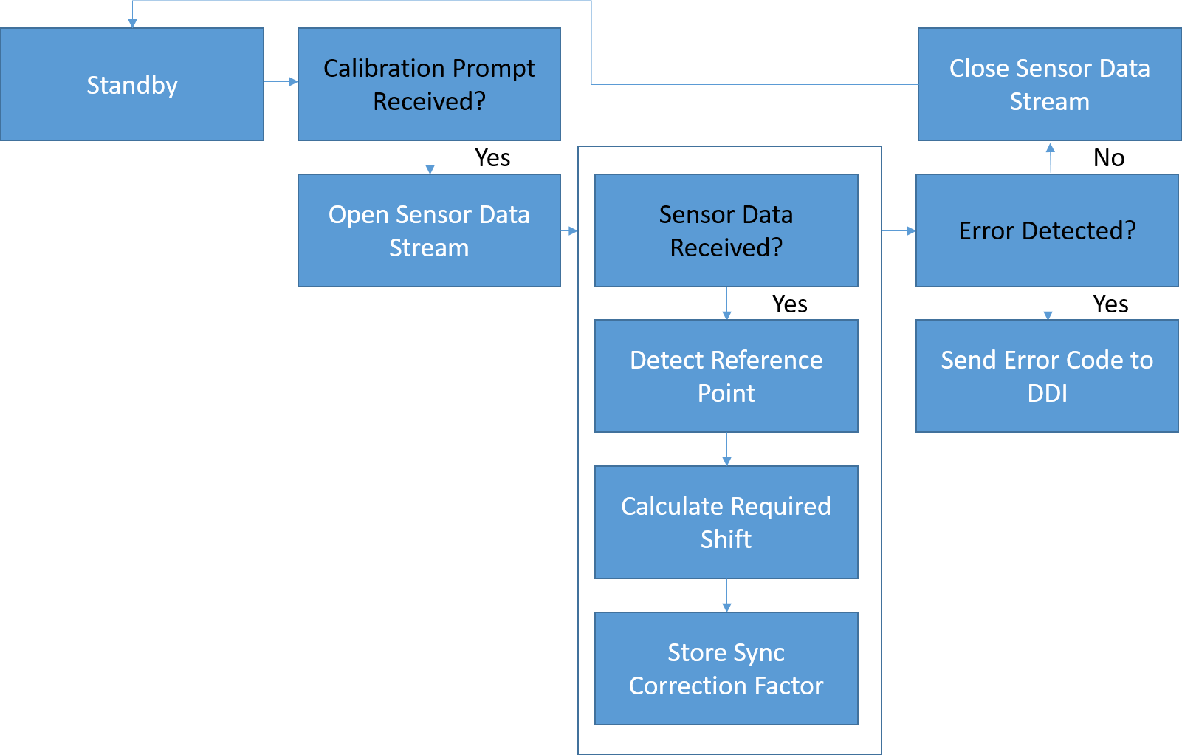
Signal Sync Flow Chart

Slide 3
Signal Sync Program Result

Slide 4
Further Refinement
System will eventually be integrated with 3 input signals
Add additional code for third input signal read in
Add additional code for processing with third signal added
Error Handling
Error throws coded for issues in synchronization
Read out format still being decided on for forwarding to data analysis and databasing
Eliminate “false” data sections that have appeared due to shift

Slide 5
Signal Correction

Slide 6
Signal Correction Flow Chart

Slide 7
Signal Correction Results

Slide 8
Further Refinement

Slide 9
System Control

